Slide 1
BTP Mid Term Presentation Supervised by : Aparajita Dasgupta by: Rohit Jain (2019MT10721) Nishant Kumar (2019MT10708)
Topic : Reproducing Kernal Hilbert Space

Slide 2
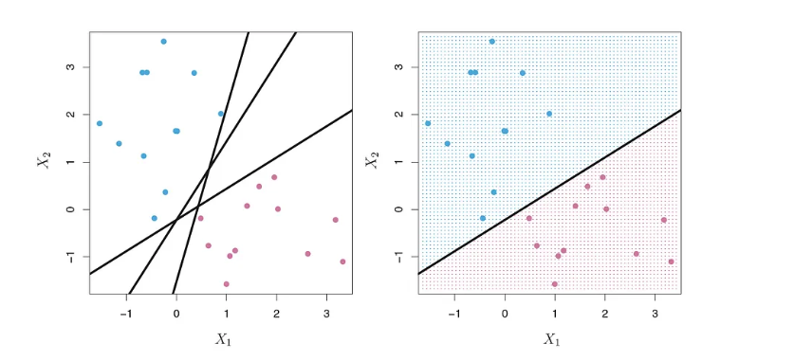
What is Kernel?
Kernel refers to a method that allows us to apply linear classifiers to non-linear problems by mapping non-linear data into a higher-dimensional space
These data points on 2D plane can be easily separated a line (1D)

Slide 3
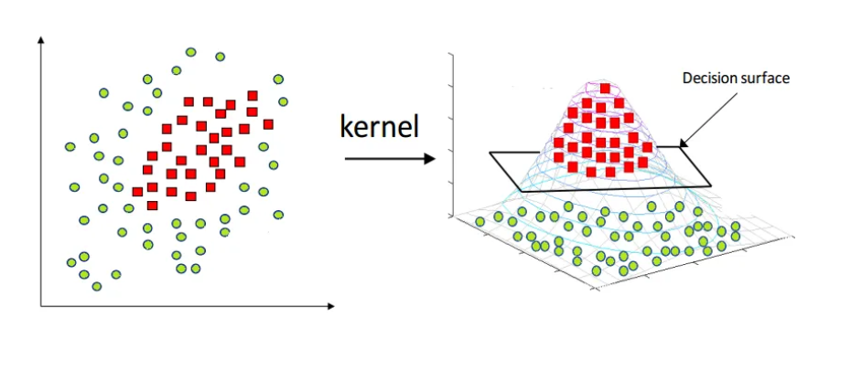
What is Kernel?
But most of real life data can’t be separated by a line
These data points on 2D plane can be transformed into higher dimension plane and then can be separated by linear model using kernelization

Slide 4
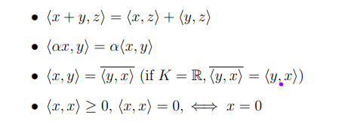
What is Hilbert space?
A Hilbert space is a complete inner product space
i.e it is a vector space equipped with an inner product and it is also complete
Inner product space is a vector space X with an inner product defined on X
Inner product is a mapping of X x X into the scalar field K of X, such that for all vectors x, y and scalar α
Complete means every Cauchy sequence of vectors in the space has a limit that is also in the space.

Slide 5
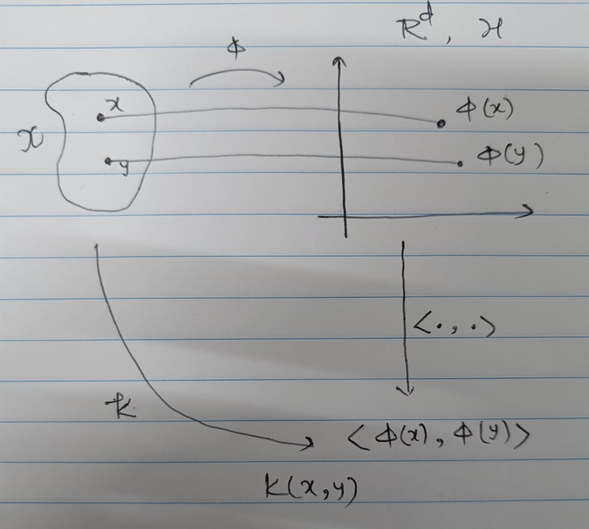
Kernel methods - the overall picture
Motive:
Given points in some abstract space X (say R^{n})
Would like to (implicitly) embed the points into some space R^{d} via a (non-linear) feature map ϕ
In that space we use linear methods like SVM
Ideally , we never compute the embedding directly.
Instead we want to use a “kernel function” to compute k(x,y)=<ϕ(x),ϕ(y)>
This approach is called the “Kernel trick” and the corresponding algorithms are called “Kernel methods”

Slide 6
Kernel implies embedding
A function k : X X X —> R (where X is our input space) is a kernel if and only if there exists a Hilbert space H and a map ϕ : X —> H such that
k(x,y)=<ϕ(x),ϕ(y)>
The above statement at first seems obvious because Given X and ϕ we can easily define the kernel function k as k(x,y)=<ϕ(x),ϕ(y)>, Here k is both symmetric as well as positive definite thus it can be used as a valid kernel. The Essence of the above statement is for a given X and k , there exist a mapping ϕ(x) in Hilbert space H for every kernel function k.
Notes:
talk about what this theorem could mean to our idea of kernels , then why the other part is not so counter intuitive until we just know it once

Slide 7
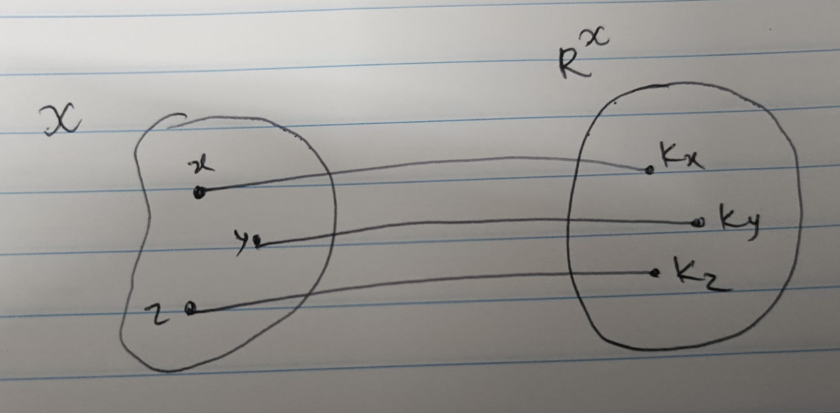
Reproducing Kernel Hilbert space (RKHS)
proof of <= (by definition)
=> We'll create a such type of space Let's Start
Consider a mapping ϕ : X —> R^{x} (where R^{x} denotes the space of all real valued functions from X —> R)
x —> ϕ(x) := k_{x} := k(x, .)
Notes:
first define phi ,then go to vector space , ofcourse we need an inner product and then finally completeness

Slide 8
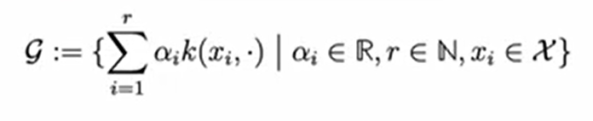
Reproducing Kernel Hilbert space (RKHS)...
Vector Space
Consider the spanning set of all image point in higher dimension
Inner Product
For spanning function we define :
<k_{x},k_{y}> = <k(x, .), k(y, .)> := k(x, y)

Slide 9
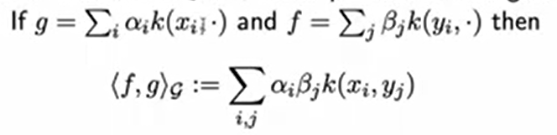
Reproducing Kernel Hilbert space (RKHS)......
In general for any g and f in vector space is basically linear combination of image points
For Hilbert space we also need the completeness
Just add all limit points of the Cauchy sequence in R^{x}
Hence We have created a Hilbert space which has the property
<k_{x},k_{y}> = <ϕ(x),ϕ(y)> (By Construction)
This constructed space is called "Reproducing Kernel Hilbert Space"

Slide 10
The reproducing property
Let f = Σ_{i} a_{i}k(x_{i},.) Then <f,k(x,.)> = f(x)
proof. <k(x,.),f> = <k(x,.),Σ_{i} a_{i}k(x_{i},.)>
= Σ_{i} a_{i}<k(x_{i},.),k(x,.)>
= Σ_{i} a_{i}k(x_{i},x)
= f(x)
Intuitively, this means that the kernel function k "reproduces" the function values of f at any point x in the domain of the RKHS. More specifically, the inner product <f, k(x, .)> measures how much of the kernel function k "matches" or "overlaps" with the function f at the point x.
Since the inner product is a measure of similarity between two functions, this means that the reproducing property implies that the kernel function k is highly correlated with the function f at every point x.

Slide 11
The representer theorem
Consider a regularized loss minimization problem of the form
minimize L_{n}(w)+λΩ(||w||_{H}) (*)
where X is arbitrary input space, Y output space, k : X x X —> R a kernel, H the corresponding RKHS. For a given training set (X_{i}, Y_{i})i=1,...,n < X x Y and classifier fw(x) = <w,x>
Let L_{n} be the empirical loss of the classifier with respect to a loss function, and
Ω:[0,inf) —> R a strictly monotonically increasing function. Then problem (*) always has an optimal solution of the form
w*=Σ a_{i}k(x_{i},.)
Notes:
show that this means that we dont need to care about any more of the points in that infinite dimensional space and then the ijmplications

Slide 12
The representer theorem - implications…
In general, the RKHS is a infinite-dimensional vector space (a basis has to contain infinitely many vectors).
All such functions have the form f(x)=<w,x> for some w ∈ H, that is we can identify the function f with the corresponding vector w ∈ H.
The representer theorem shows that in practice, we only have to deal with a finite-dimensional subspace.
The representer theorem now says that for any finite data set with n points, we don't need to deal with all the infinitely many dimensions, but we are only confronted with a space of at most n dimensions.

Slide 13
Universal Kernels
Note that without any further assumptions, the feature map ϕ : x —> H of a kernel k does not need to be injective! (simple counter example: k(x,y)=<x,y>²)
However, a kernel for which the feature map is not injective might not be too useful
A particular class of “nice” kernels are universal kernels. With a universal kernel, we can approximate pretty much any function we like: all continuous functions, and all functions that can be approximated by continuous functions (such as step functions). In particular, we can separate any pair of disjoint compact subsets from each other.
The Gaussian kernel with fixed kernel width σ on a compact subset X of R^{d} is universal.
Notes:
given a kernel k and and a compact set X , and if we construct a RKHS on that set with the given kernel , the space H is dense in C(X)

Slide 14
Future Scope!!
Kernel Methods in Machine Learning: We can explore the use of RKHS in support vector machines (SVMs) or kernel-based clustering algorithms to classify data points or identify patterns in datasets.
Image Analysis and Computer Vision: We can investigate the use of RKHS in image denoising, image segmentation, object detection, and recognition.
Time Series Analysis: We can investigate the use of RKHS in time series forecasting, anomaly detection, and signal processing.
Functional Data Analysis: We can explore the use of RKHS in functional regression, classification, and clustering.

